Slide 1
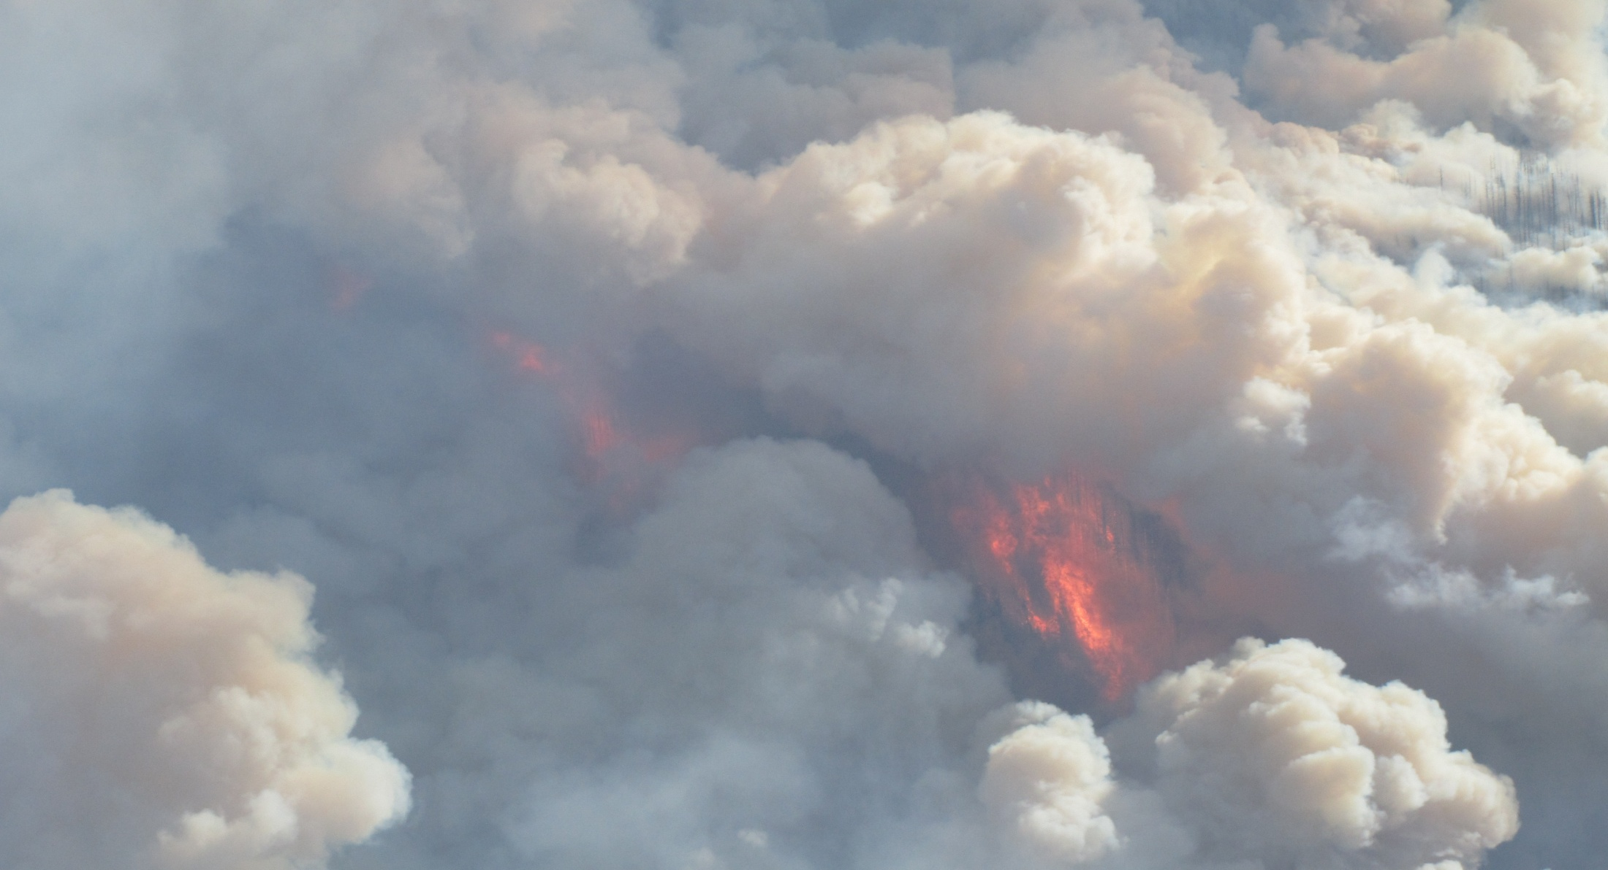
VA0955 Dean River
AUGUST 2 - 2010

Slide 2
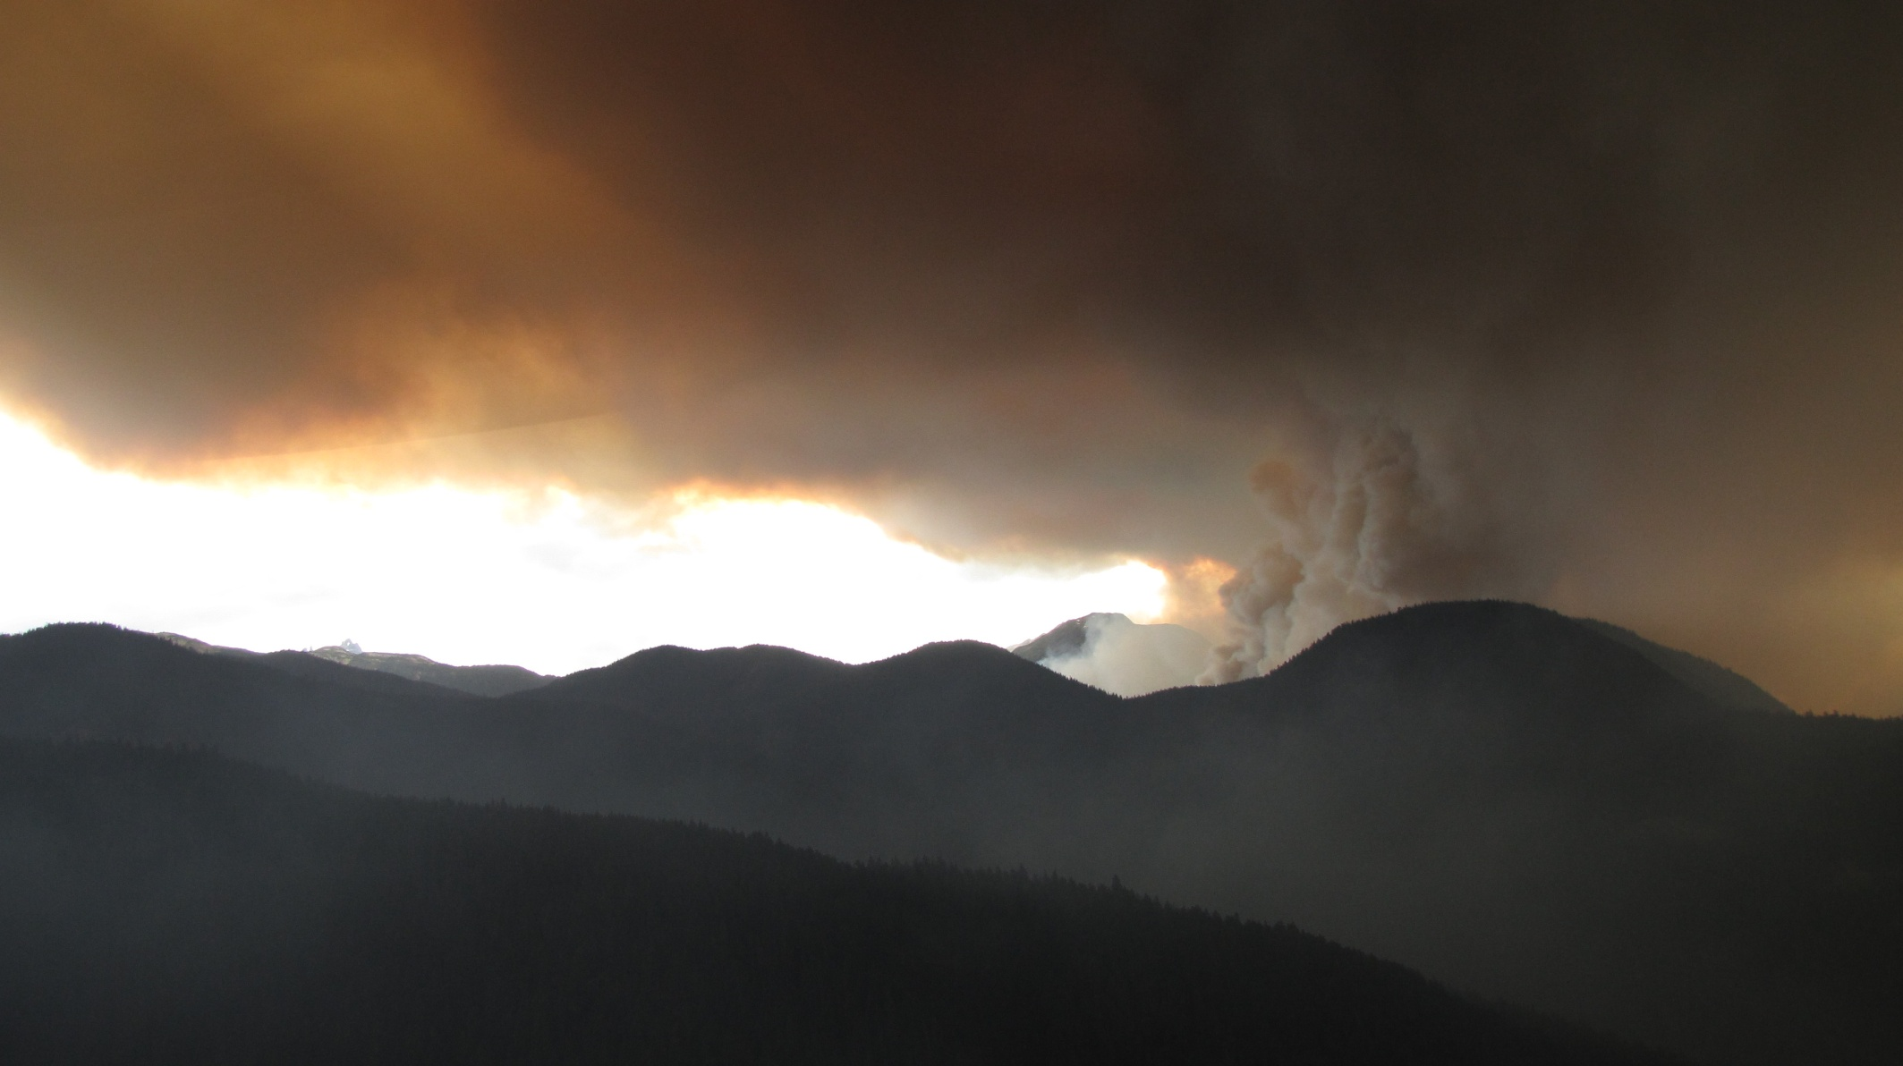
History
IGNITION – AUGUST 2 @ 21:16. LIGHTNING
DISCOVERED – AUGUST 14th ON MODIS @ 100 HA
GROUND ATTACK – AUGUST 16 @ 15:45 HR (EVACUATION ORDER ISSUED)
Notes:
Lightning patrols did not detect fire. Fire was discovered using MODIS satellite infrared technology almost 2 weeks post lightning storm. Initially resources at the Mid Coast Fire Base in Hagensborg were insufficient to mount an effective response beyond beginning sprinkler set up at Hodson’s upper fish camp.

Slide 3
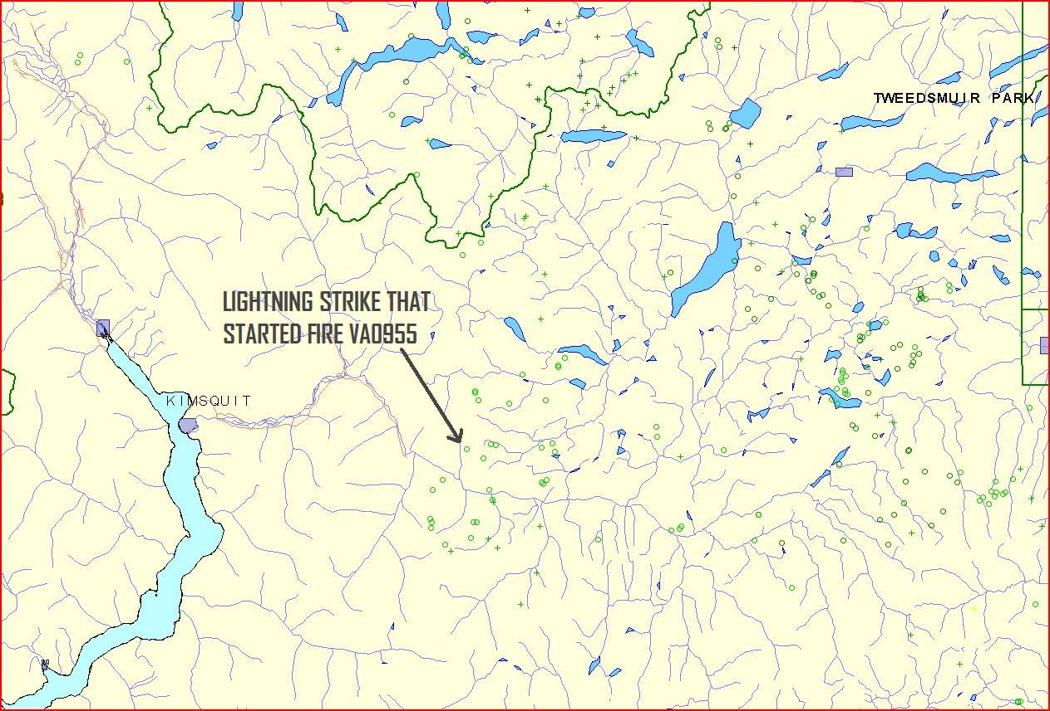
Aug. 2,
Lightning Map

Slide 4
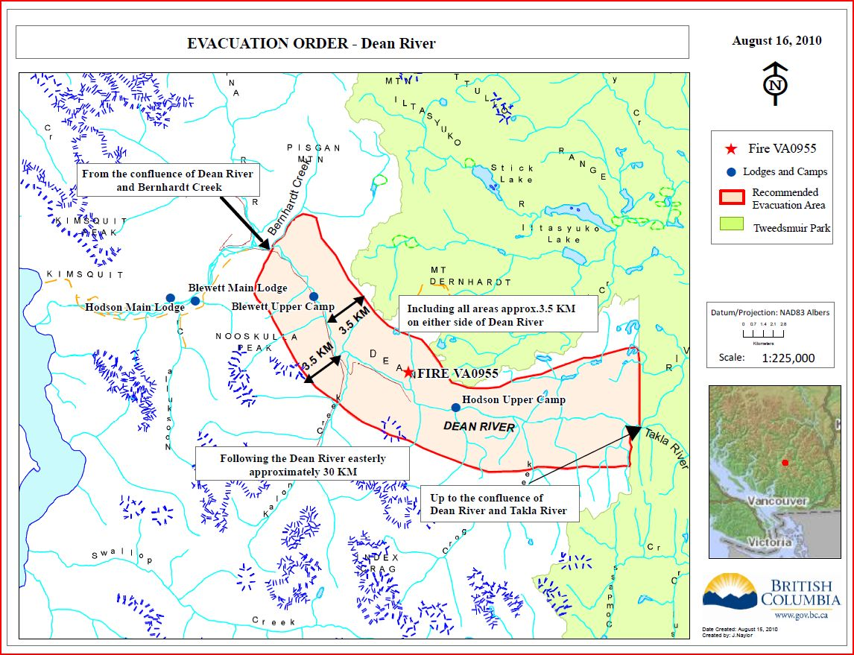
Evacuation Order

Slide 5
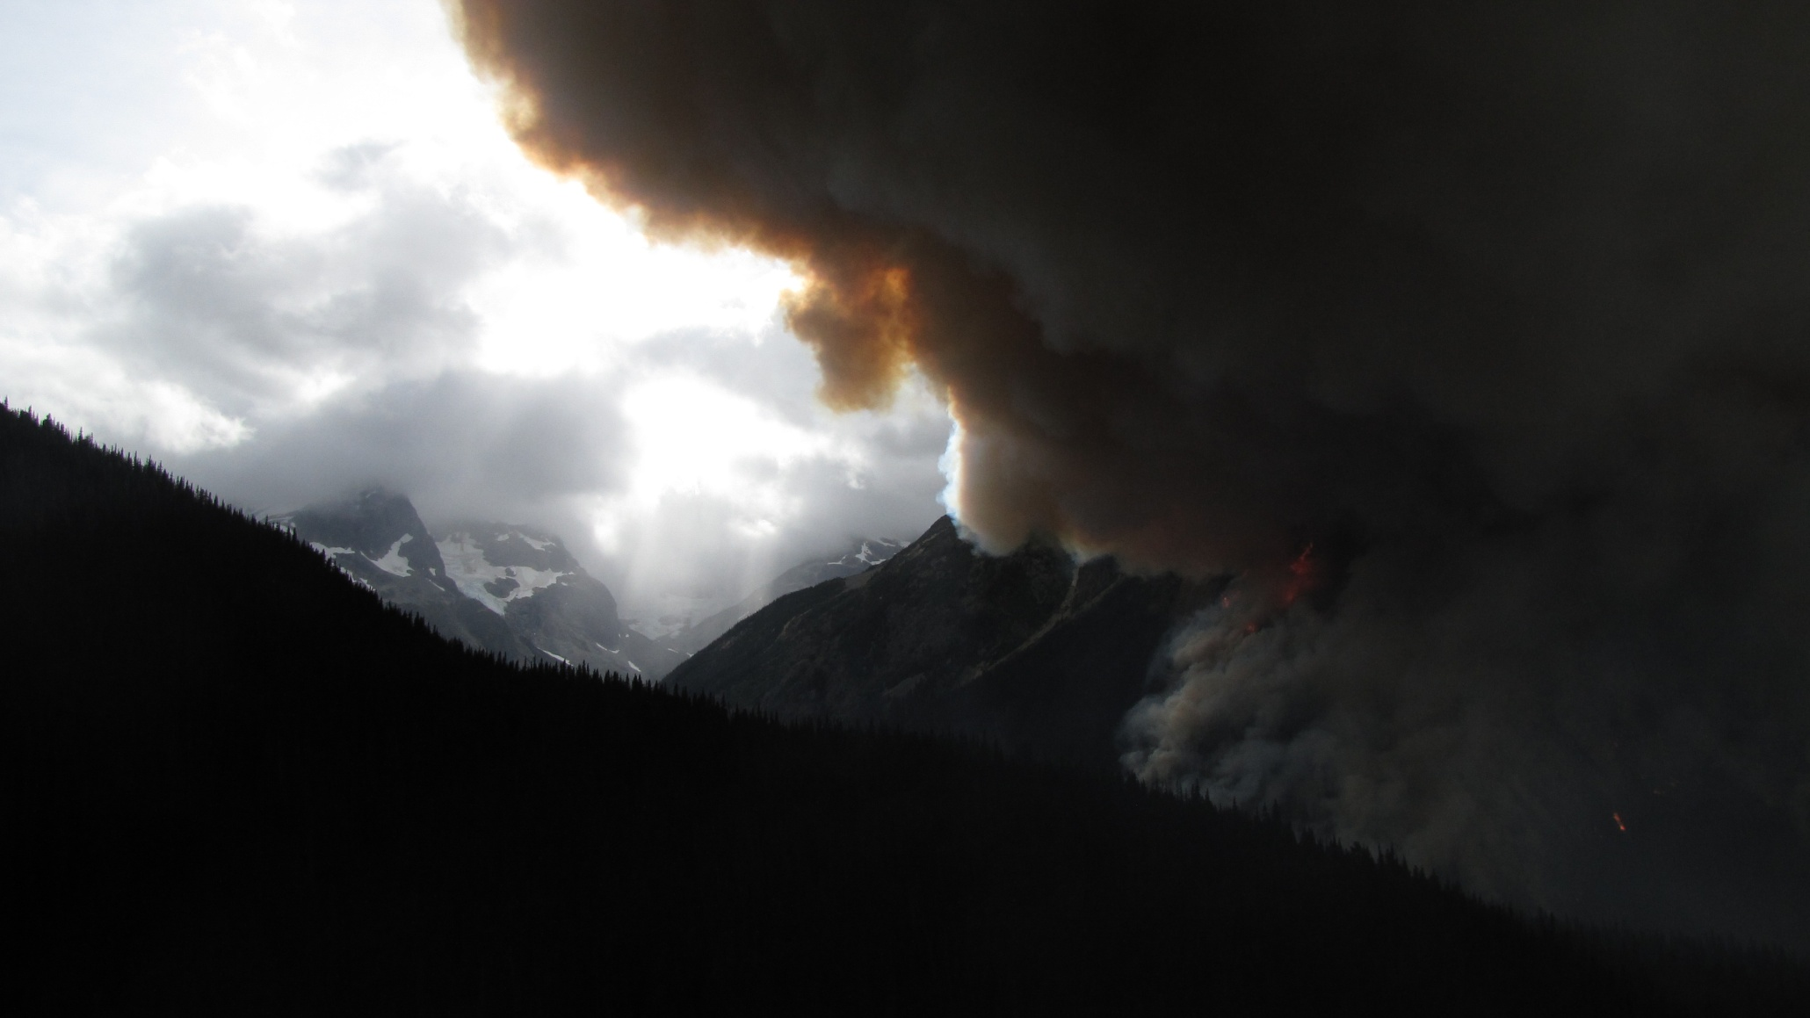
Incident Commander
AS IC MY CONSIDERATIONS :
Safety of first responders and public
Ascertain objectives (Fire Analysis)
Set priorities and identify tasks
Establish contingency lines
Ensure adequate resources
Ensure communications: fireline and other
Establish trigger points for evacuations

Slide 6
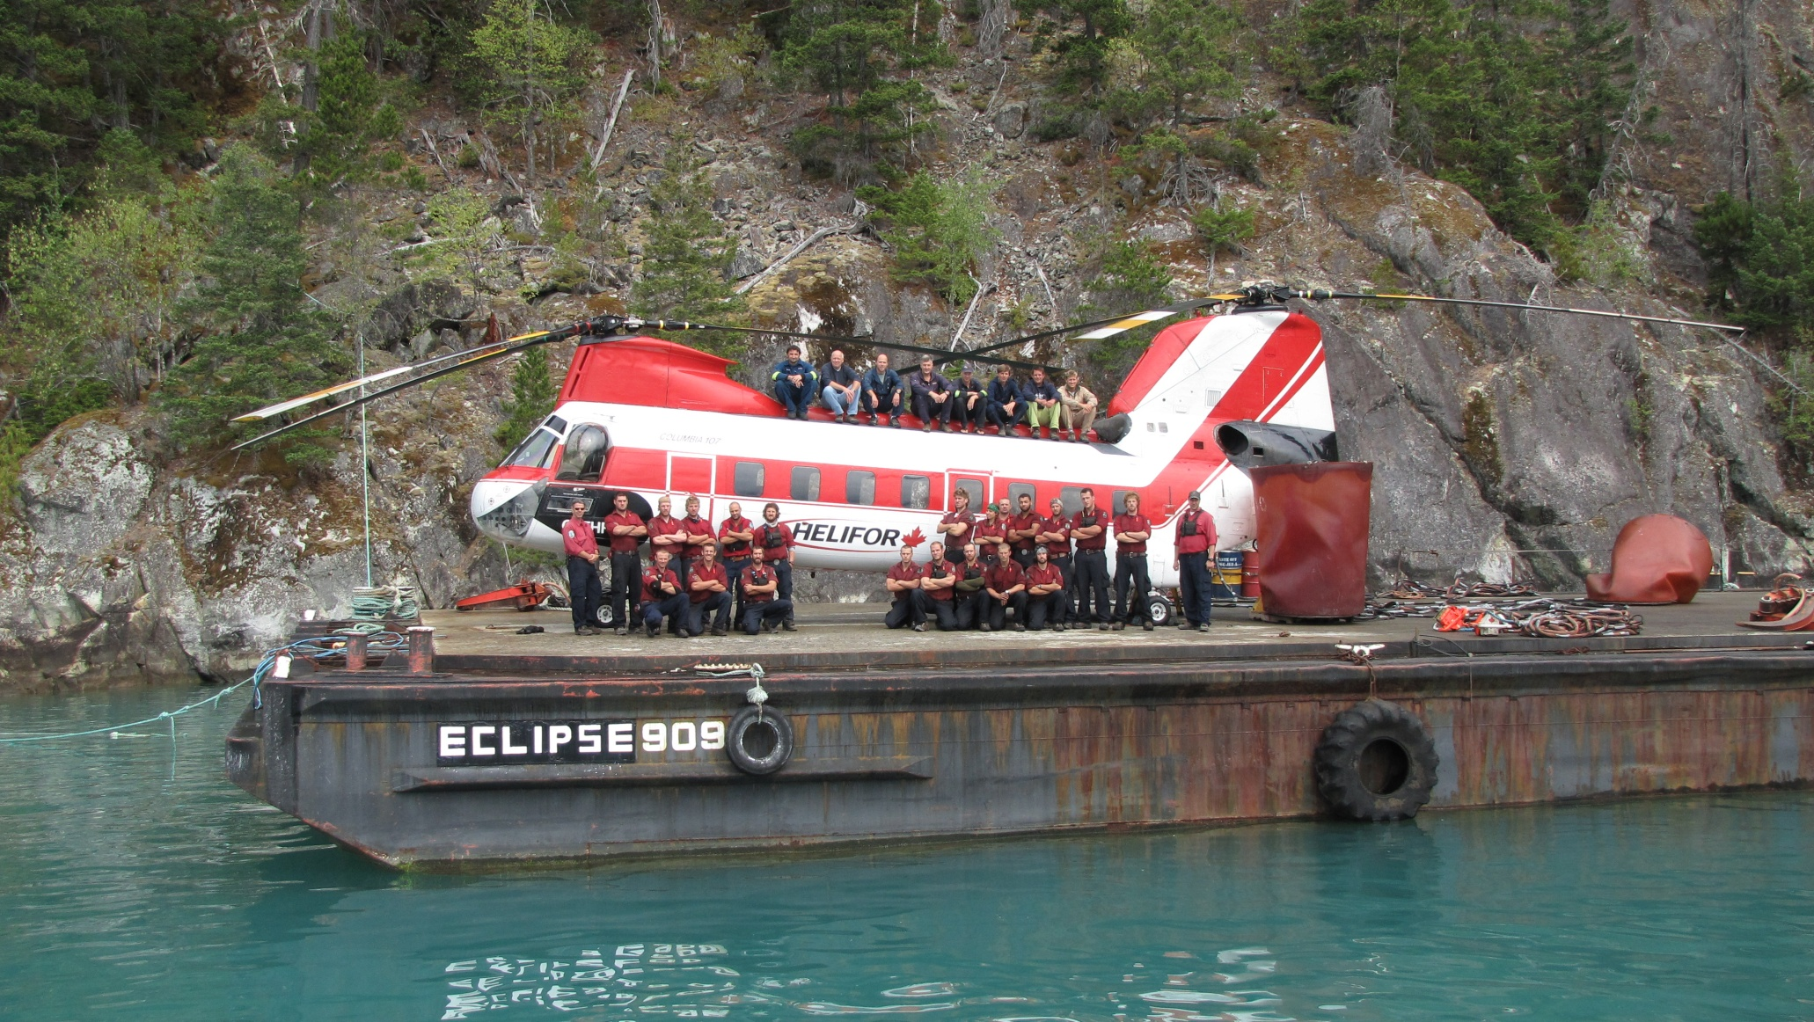
Provincial Situation
Several large interface fires burning provincially meant relatively few resources available for this fire.
ONE – 20 person unit crew + I.C. + HEL-CO
4 helicopters; 1 each of Heavy, Medium,
Intermediate & Light helicopters
Notes:
Interface fires in the Cariboo, PG and NW Fire Centres and many dozens of other fires, limited resources available for the Dean River remote access fire. - Values at risk in Dean River consisted of two guide companies with established fishing cabins /camps, and the Dean River Conservatory itself.
The Dean River is world famous for having the #1 rated summer steelhead run on the planet.
The fishing guide companies cater to exclusive high-end clientele, resulting in economic considerations for local businesses & government.

Slide 7
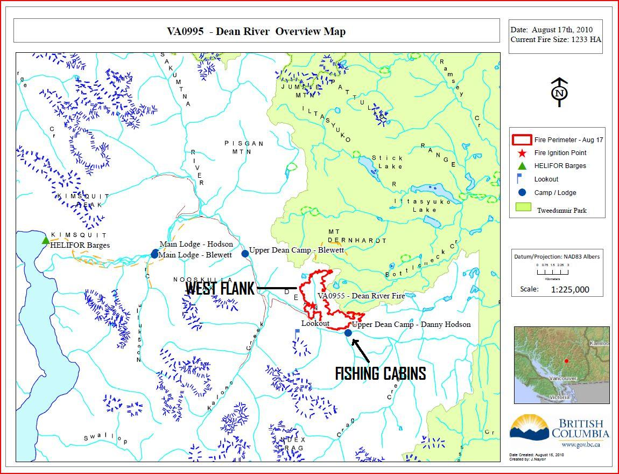
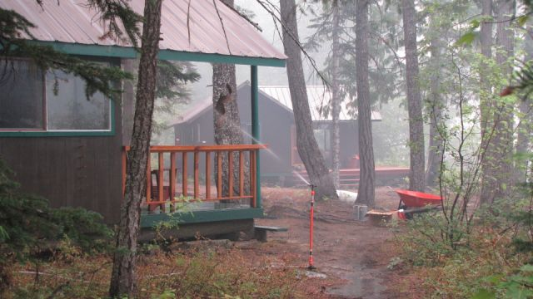
Priorities - Aug. 17
Notes:
Sprinkler system was established and working well at Hodson’s upper fish camp to protect cabins.

Slide 8
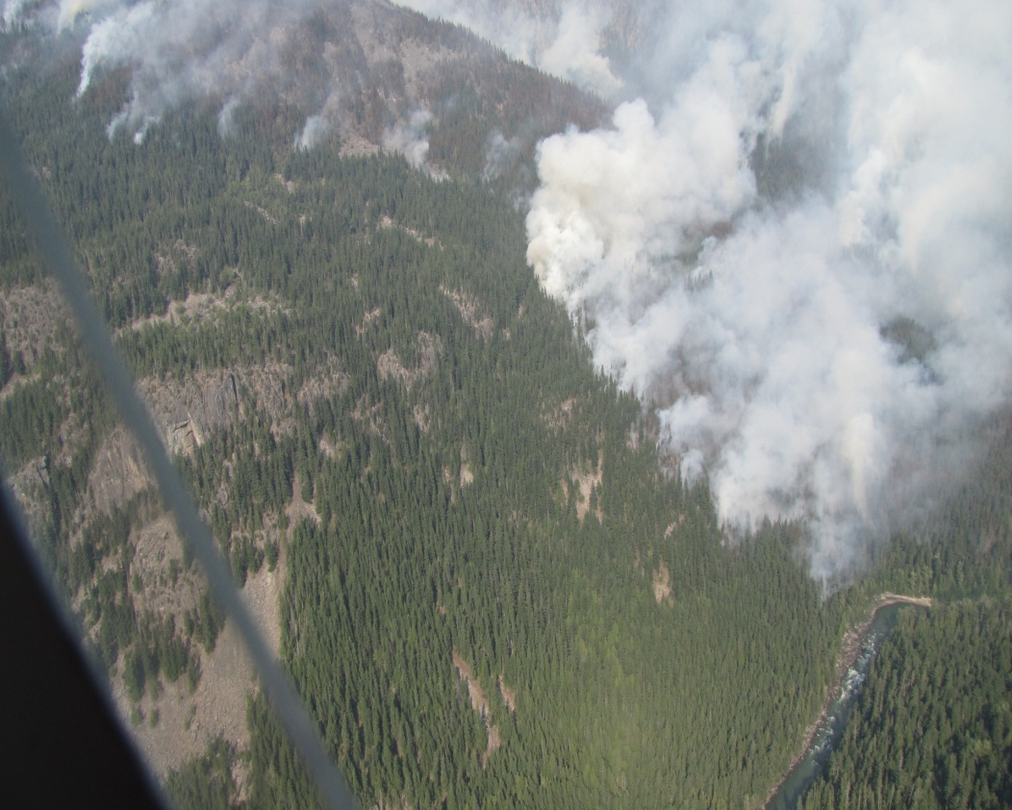
Priorities – Aug. 17
Notes:
Crew’s objectives were to establish control lines along the west flank, anchoring off river and constructing a heli-pads for safety / access. Helicopter bucket machines worked upper west flank until crews could move their control line uphill. Plan is to stop westward movement of fire towards other fishing lodges downriver. We were also trying to push the fire uphill and out of the valley bottom.
Also, hopes are to keep the fire contained to the north side of the river. Limited resources dictate that we do not have enough manpower to extinguish fire perimeter along river. I’m hopeful the river will will be able to hold the fire, but have doubts given the winds forecasted.

Slide 9
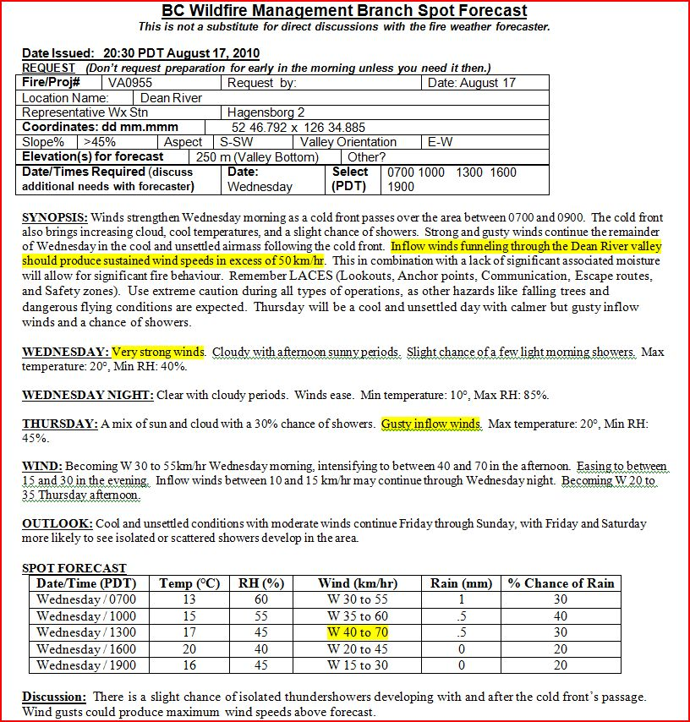
Fire Weather
High winds forecasted for August 18th indicated fire will grow in size considerably and threaten fire fighter safety and private property within the path of wind-driven fire.
Notes:
This fire behaviour advisory received the evening of Aug.17th certainly caused concern in regards to whether we would be able to hold the fire to the north side of the Dean River and save Hodson’s cabins at the upper fishing camp.

Slide 10
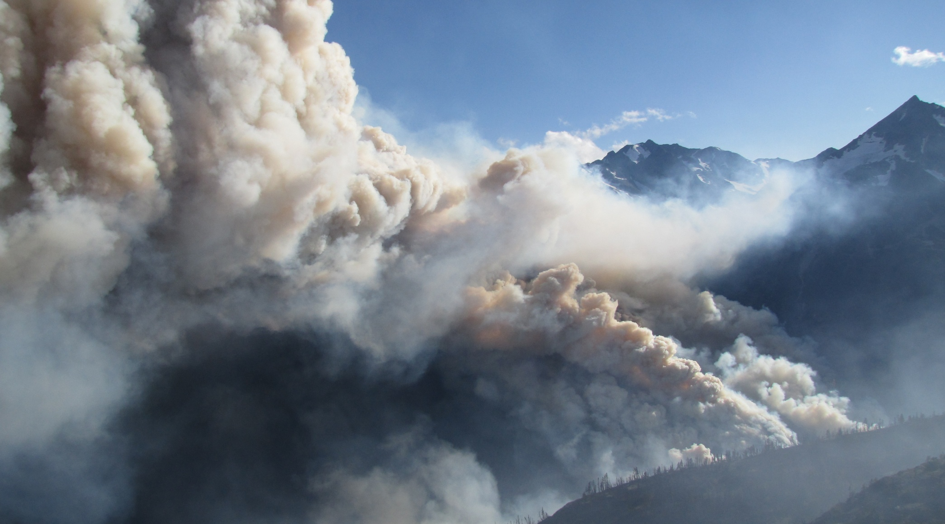
Blow Up- Aug. 18th
17:00 HOURS + -
Notes:
At approximately 17:00 hours the fire, driven by high winds, jumped across the Dean River (south side) and grew in size exponentially. Crews had been pulled out of harm’s way earlier in anticipation of forecasted wind event. The fire also grew much larger on the north side of the river. Due to smoke and visibility issues we unable to determine the fate of fishing cabins at Hodson’s upper camp until the following day.

Slide 11
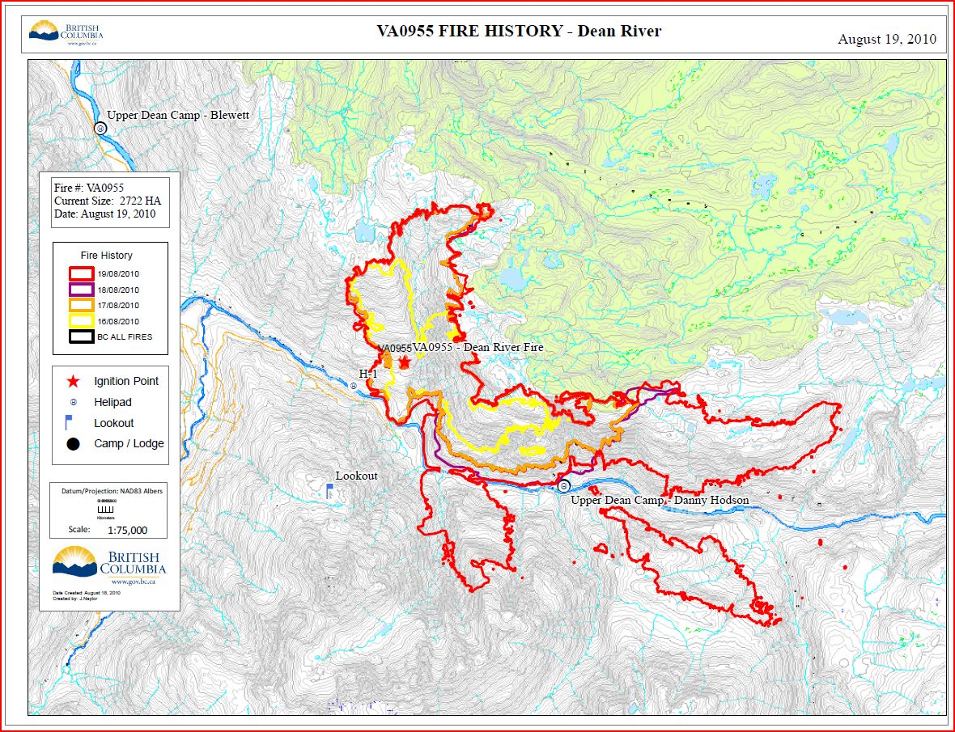
Fire Growth
Notes:
Red line indicates fire growth for August 18th. Note spotting activity to the east. Although spared during the August 18 blow up, Hodson’s cabins at upper camp were now completely surrounded by fire with ample unburnt fuel around them, making them very susceptible to both inflow and outflow wind events, which occur daily in this valley.

Slide 12
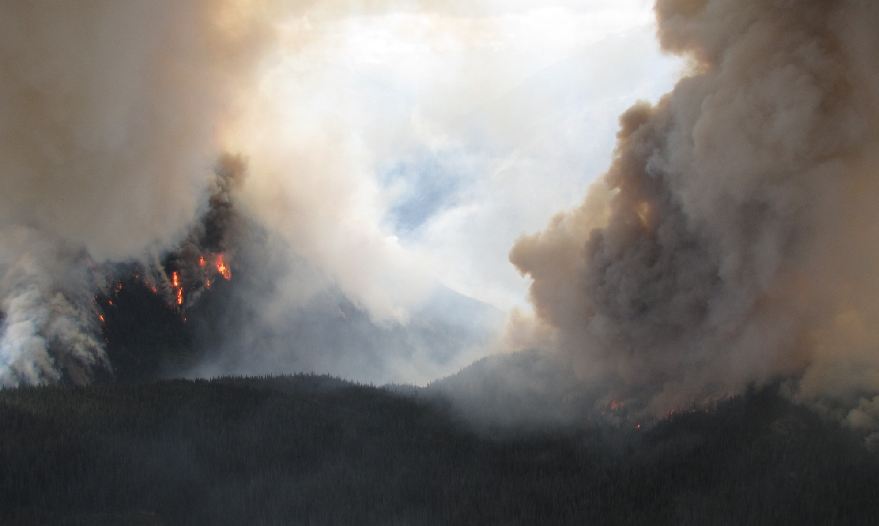
Fire Activity- Aug 19th
AUGUST 19th
FIRE WAS STILL ACTIVE MORNING OF AUGUST 19th

Slide 13
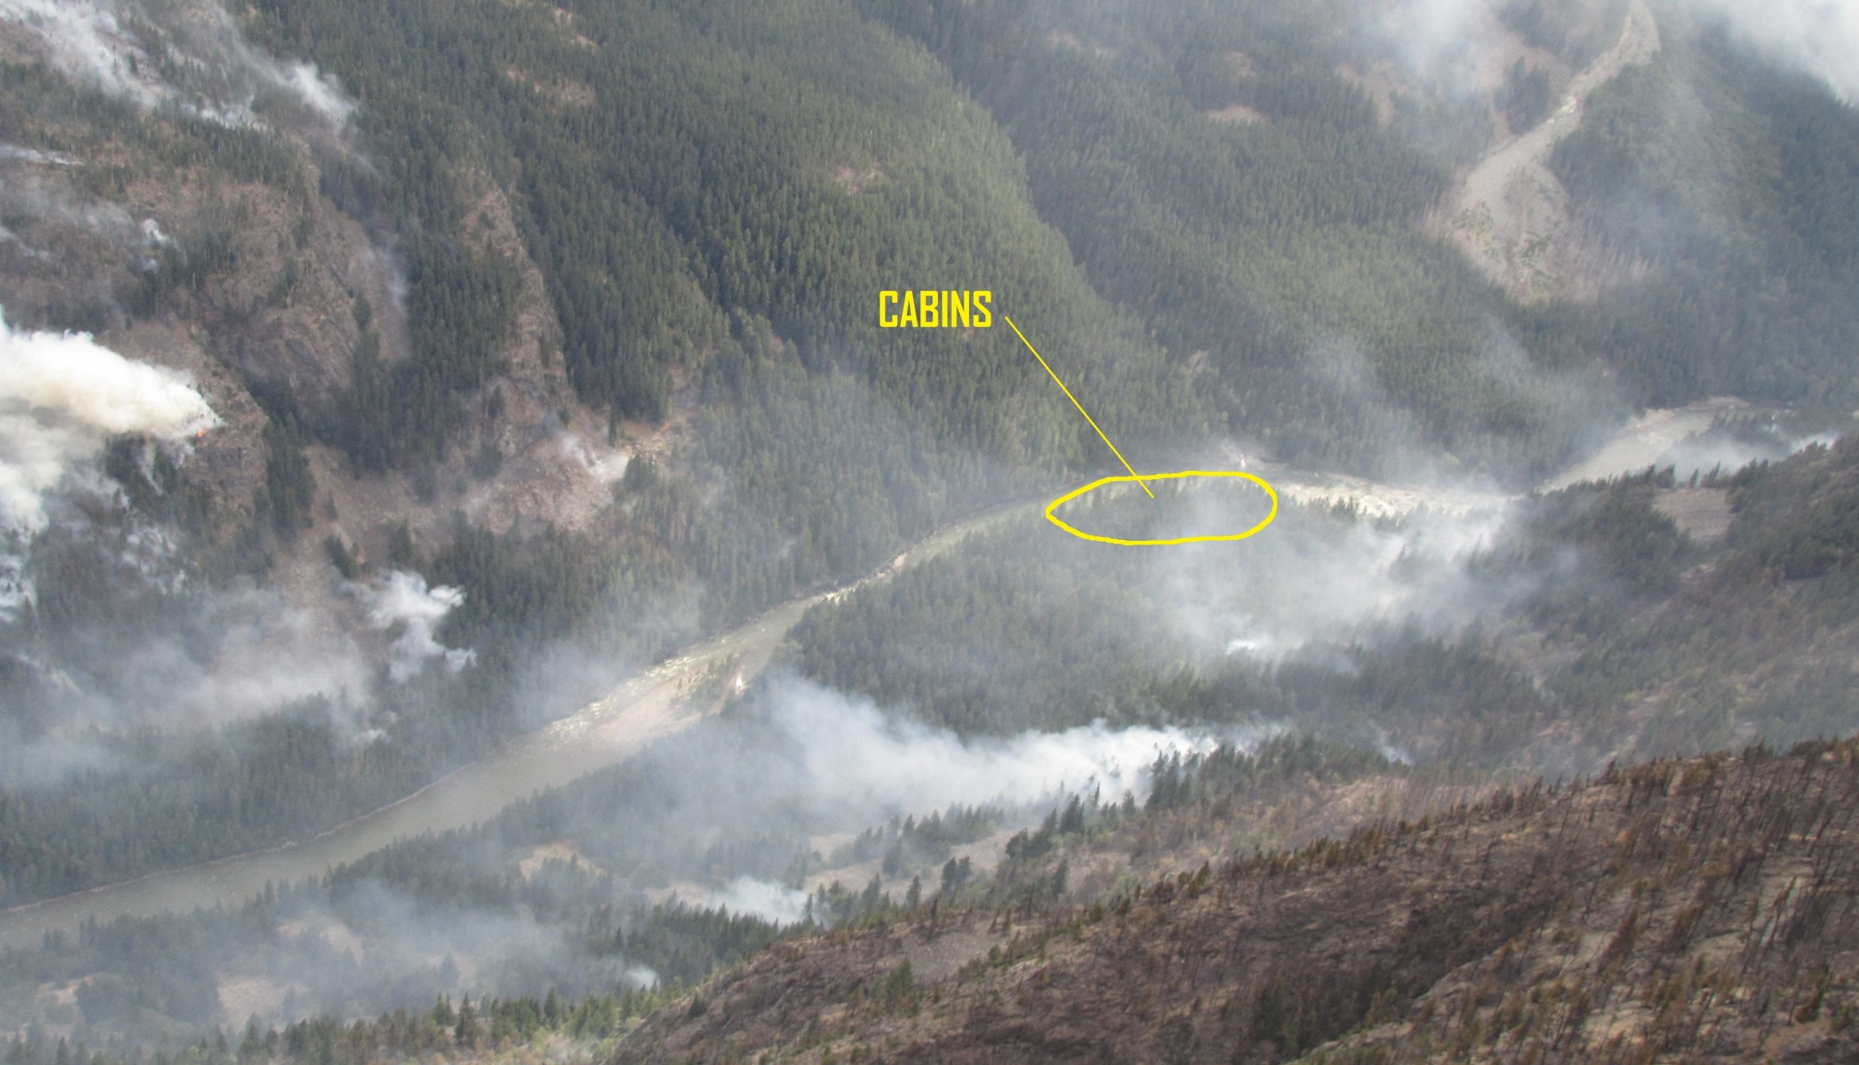
The Plan - Cabins
CONTROLLED BURN LINES
Notes:
Luckily, the cabins at Hodson’s upper camp were spared during the blow-up of August 18th, however fire spread had encircled the camp from above (north) and to the east and west. Fire had also spread to the south side of the river east and west of the cabins location. All fire spread was in a ‘dirty’ (ample unburned fuel within the burned area) burn pattern with edges that were unreachable due to terrain, or isolated due to spotting leaving a lot of unburned fuel in close proximity to the cabins. With so much unburned fuel and active fire in close proximity to the cabins they were still at very high risk of burning should another wind event occur that would cause more ‘blow-up’ conditions. A decision was made to conduct a controlled burn on the south side of the river and at the base of the slopes on the north side of the river to remove all unburnt fuels around the cabins and allow for fire lines that were easy for crews to access and control. Enough green space was left around the cabins to preserve the integrity of the aesthetics of the site for future guests.

Slide 14
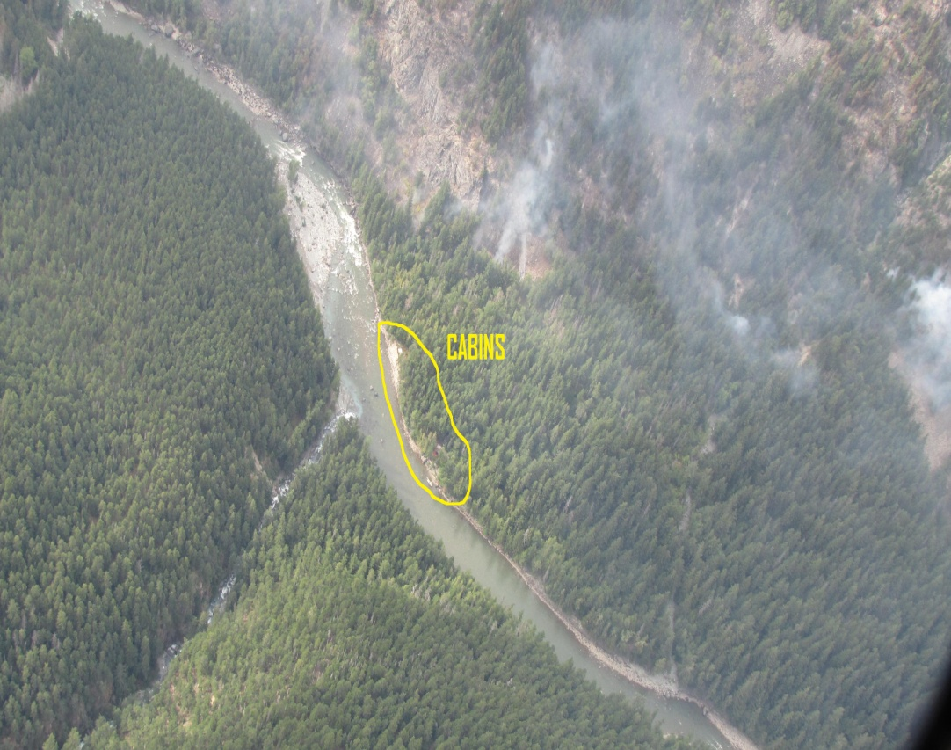
Cabin Overview

Slide 15
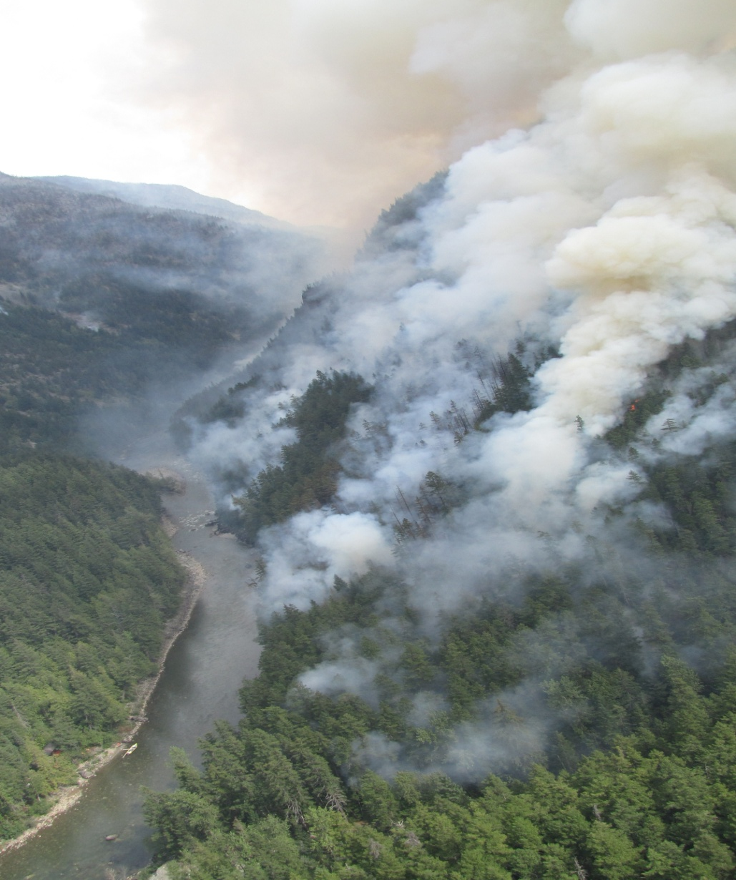
Implementing Plan – Controlled Burn
Photo of controlled burn on south side of river across from cabins. Burn was lower intensity ground fire for most part. Burn off removed fuel, thereby eliminating any chance of fire moving through area with high intensity causing fire brands to spot across river and into cabins.
CABINS AND DOCK
Notes:
Ignition was by a select group of firefighters using drip torches. They were supported by a intermediate helicopter.

Slide 16
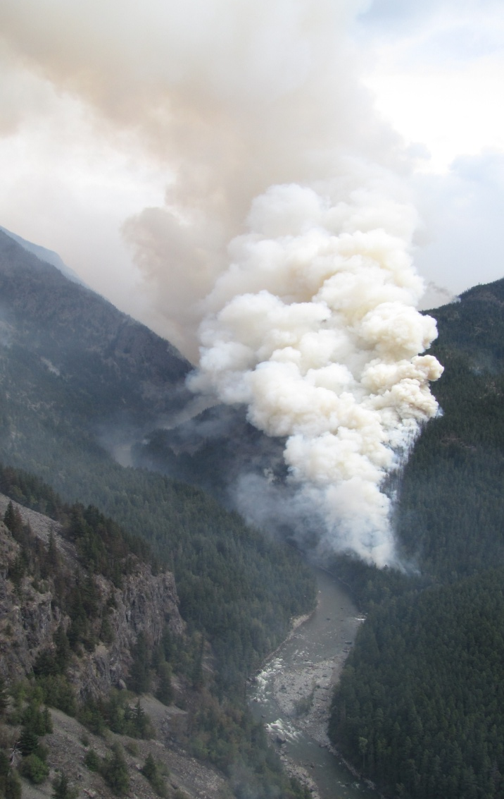
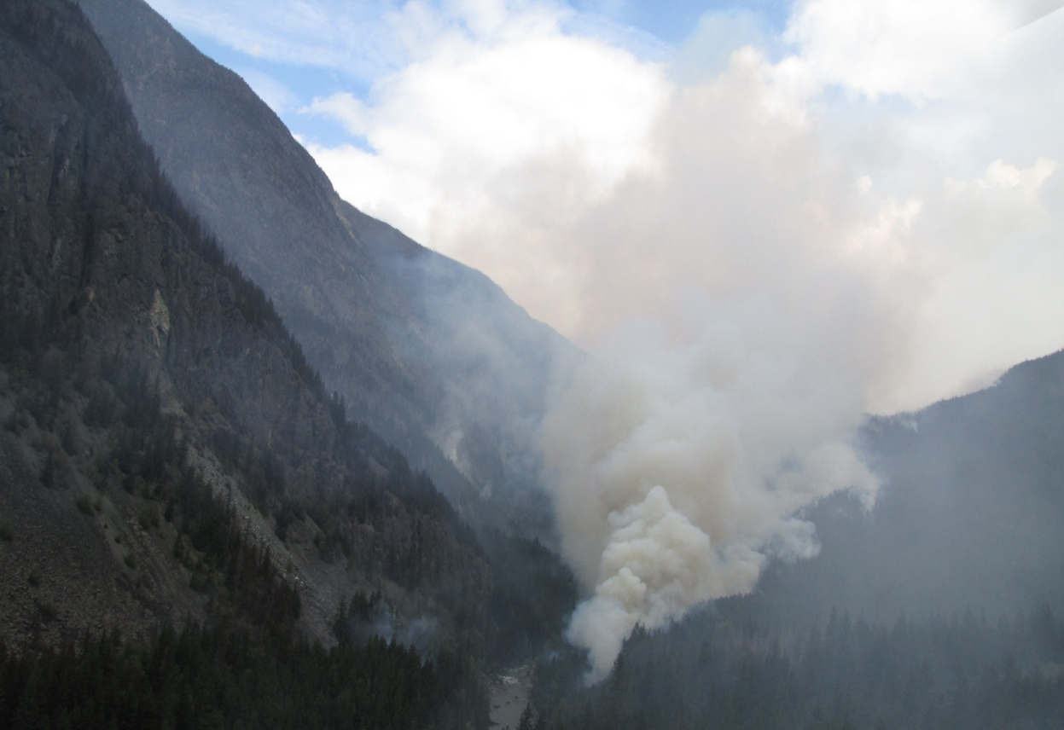
Burn Out
Photos of controlled burn across river from cabins

Slide 17
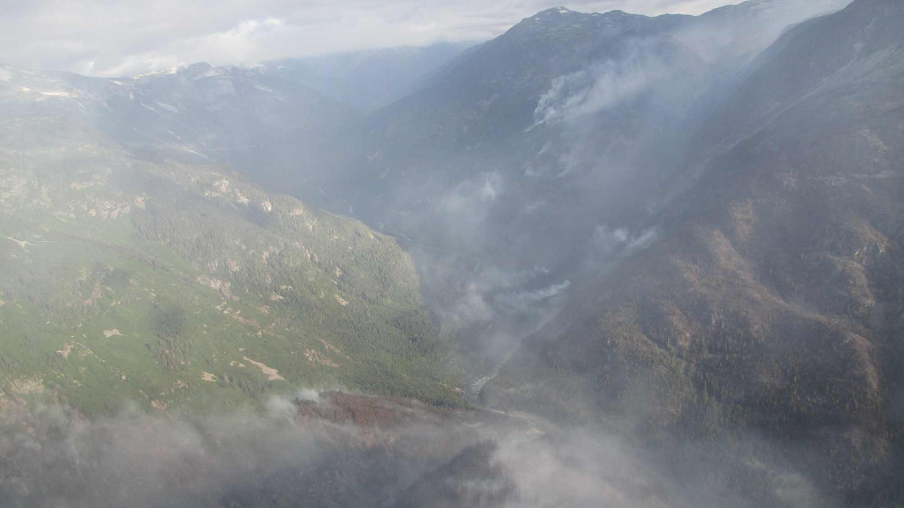
The Plan – West Flank
AUGUST 19
CONTIGENCY LINE
FIRE PERIMETER
Notes:
Contingency lines consisted of either changes in fuel type and /or creek draws. Potential course of action along contingency lines were burning off.
General objectives were not to completely extinguish the fire with limited resources on-hand, but rather to force the fire uphill and prevent further movement down low in the valley during forecasted and diurnal outflow winds.

Slide 18
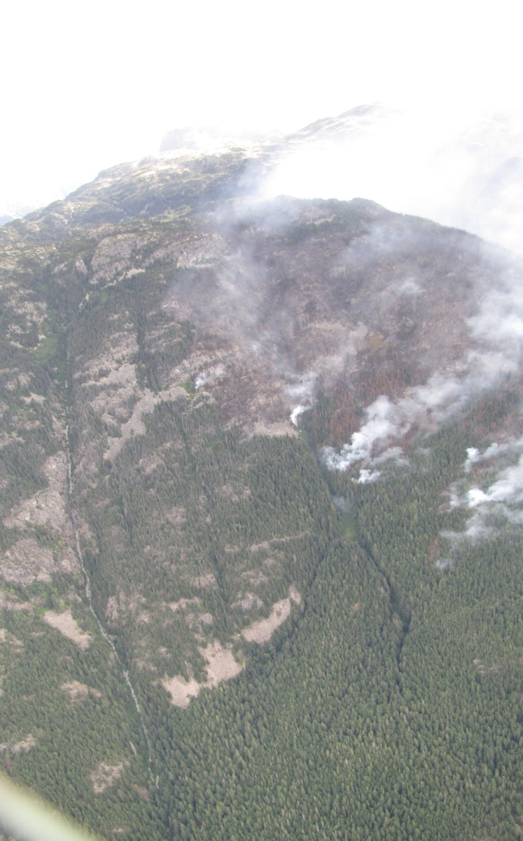
North Side - River
FIRE PERIMETER
CONTINGENCY

Slide 19
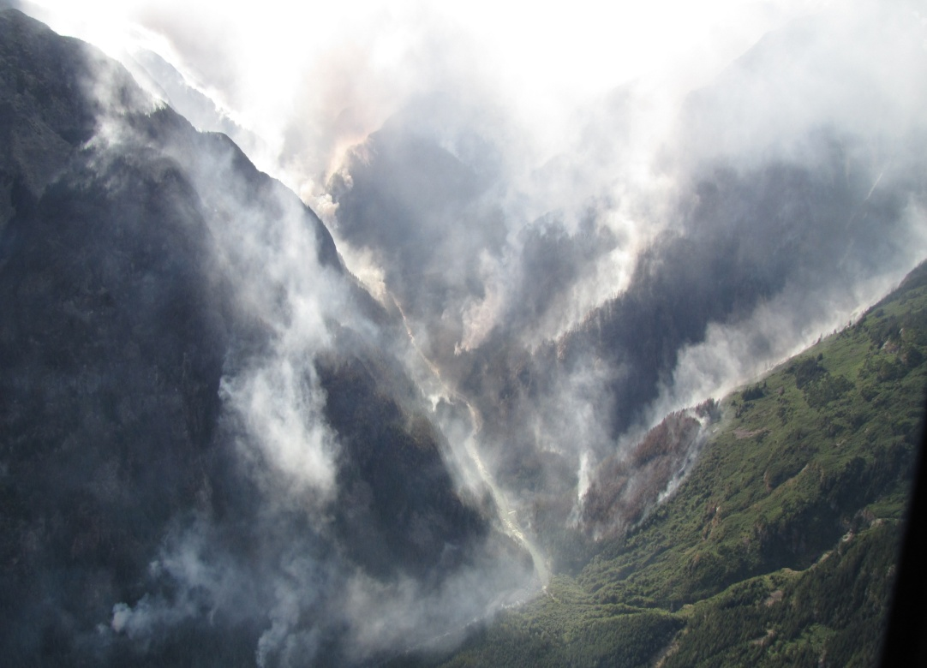
South Side – River
FIRE PERIMETER
CONTINGENCY

Slide 20
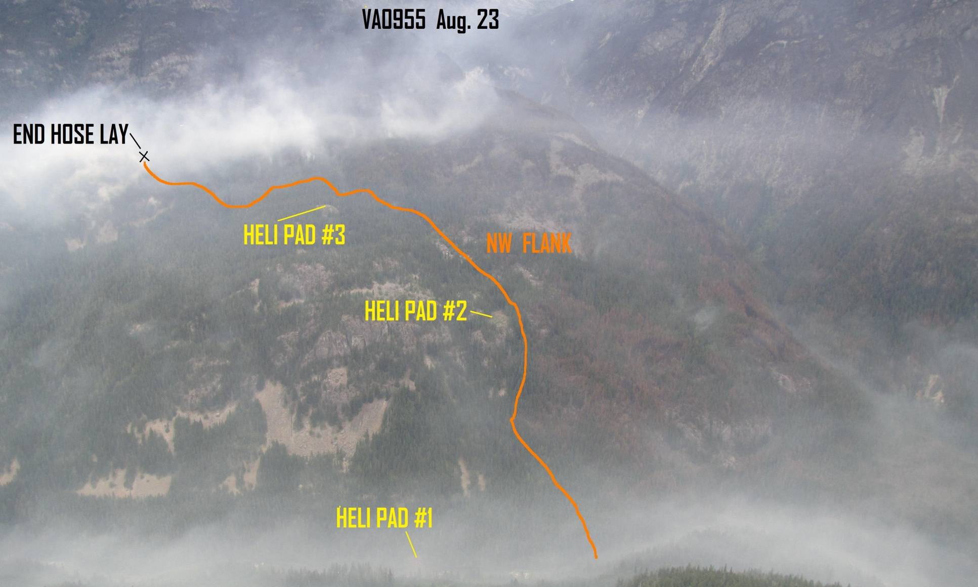
Implementing Plan –
North West Flank
Notes:
The plan for the northwest flank was to use crews and water delivery to extinguish the fire low in the valley bottom, and progressively work uphill to a point where the fire could be left to it own devices, but avoiding any erratic fire behaviour in the valley bottom and not generate enough energy to experience any major uphill runs. The crews progressively installed heli-pads the further uphill they went in order to accommodate easier access into the fire and establish safe egress points. Steep terrain and many hundreds of danger trees challenged progress and safety. Crew situational awareness was of paramount importance. The plan was stop significant movement to the west and towards fishing cabins down valley.

Slide 21
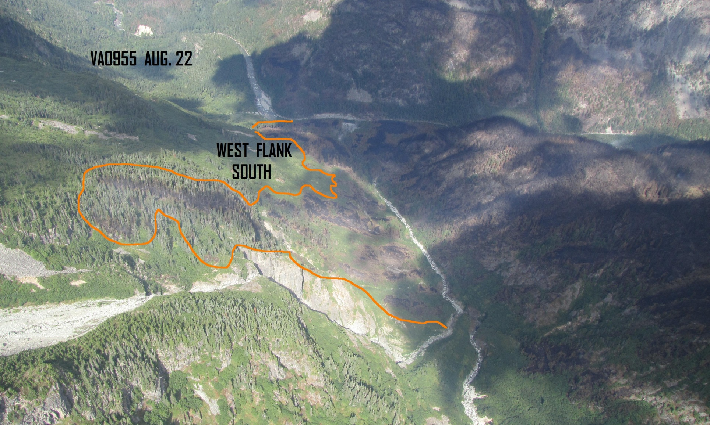
Implementing Plan –
Southwest Flank
Notes:
Helicopters with buckets were used to control fire spread on west flank/south side of river. Crews were extended and maxed out while engaged at the cabins and west flank on the north side of river. Note fuel type change from timber to buck-brush which also aided in retarding fire spread. The plan was to force the fire uphill away from river to limit any fire spread down river towards fishing cabins and prevent any explosive uphill runs.

Slide 22
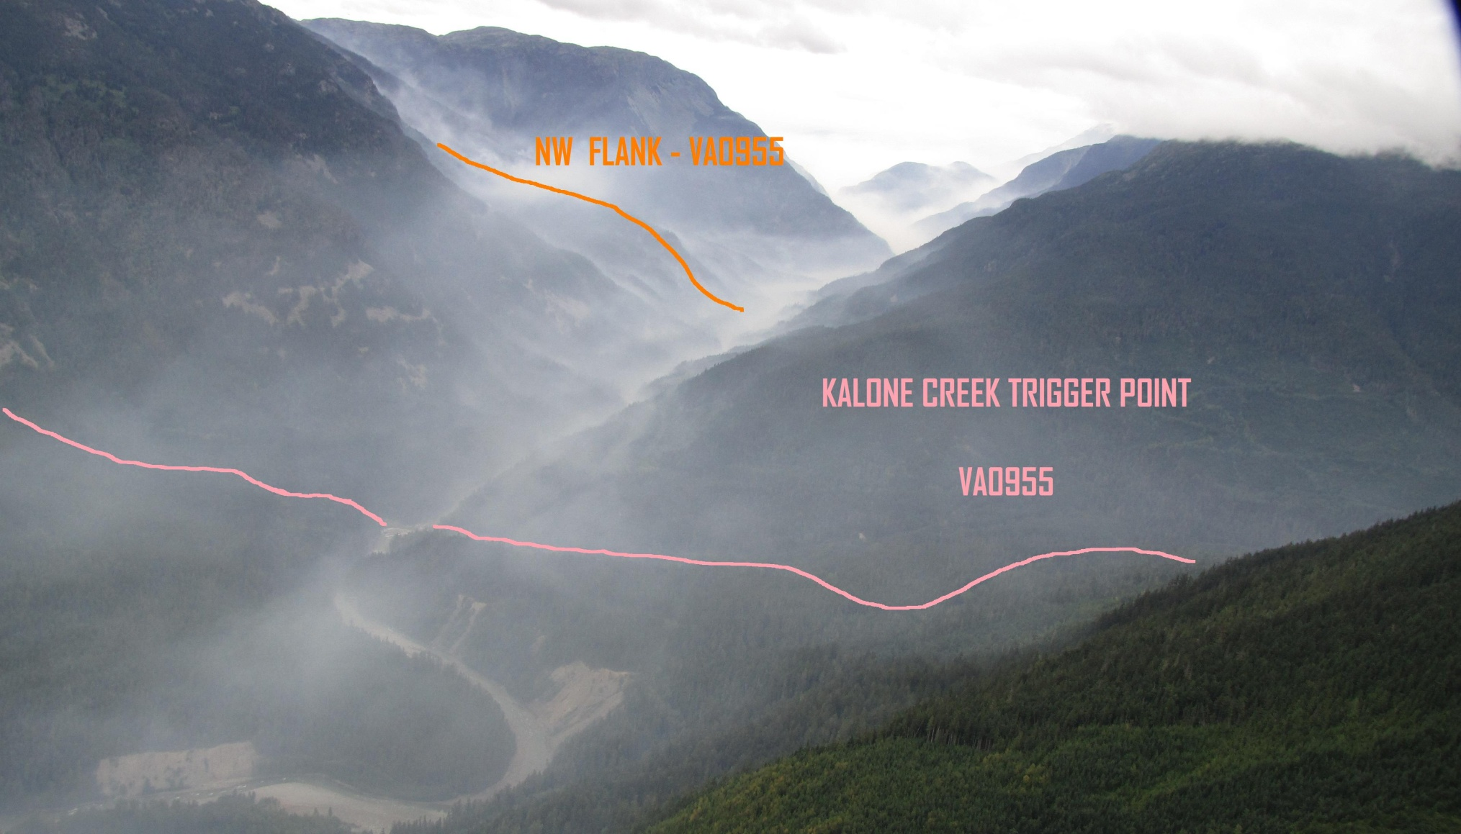
Evacuation Trigger Points
Notes:
A trigger point was established down valley at Kalone Creek. Should the fire have reached this point it would have prompted another evacuation order for the Blewett’s and Hodson’s primary fishing lodges down river.

Slide 23
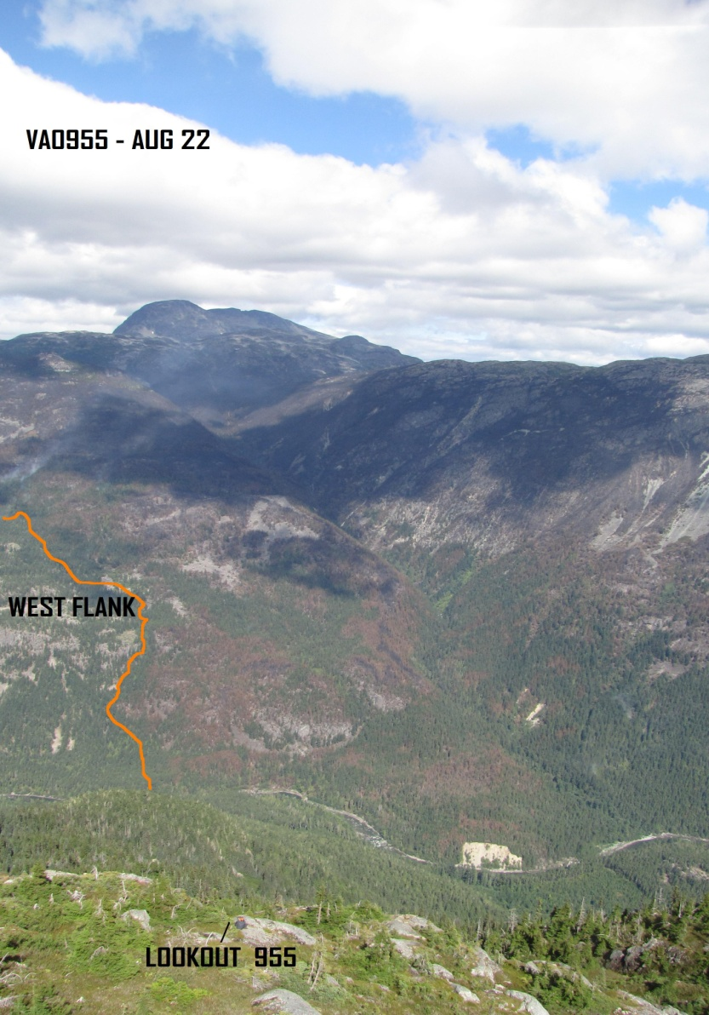
LOOKOUTS
LOCATION OF LOOKOUT 955
Notes:
A lookout location was established early in fire control operations and maintained throughout suppression efforts. Utilizing a lookout position on fires that have potential for explosive fire behaviour is mandatory. Grounds crews rely upon the lookout to notify crews of any observed fire behaviour that could threaten their position. When notified of potentially threatening fire behaviour ground crews will move into pre-identified safety zones. Lookouts also take hourly weather readings and act as a communication link for resources on the ground and in the air

Slide 24
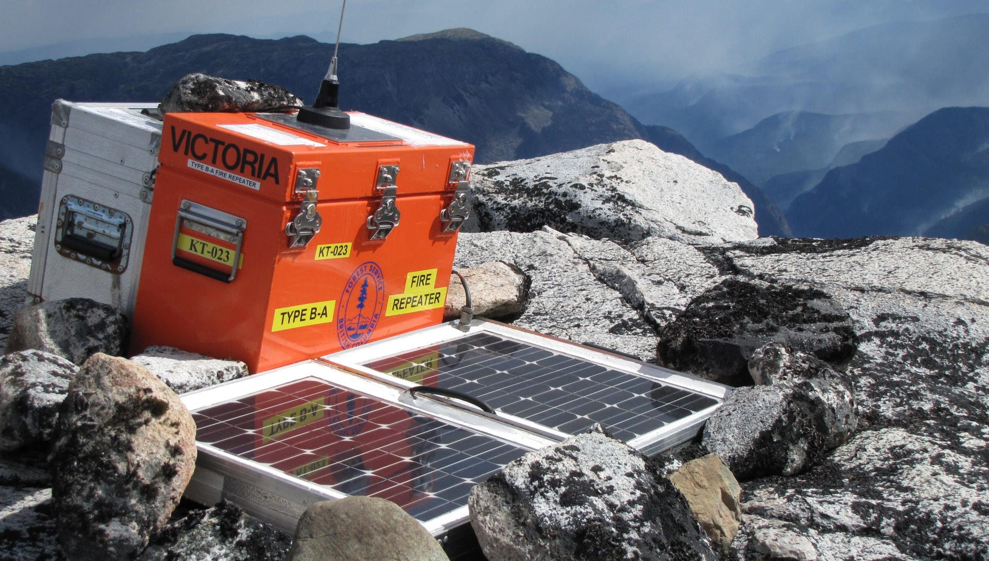
Communications
FIRE
RAINBOW REPEATER
Notes:
Poor on site communications required the set up of mobile repeater to link crews and aircraft with existing radio repeater infrastructure.

Slide 25
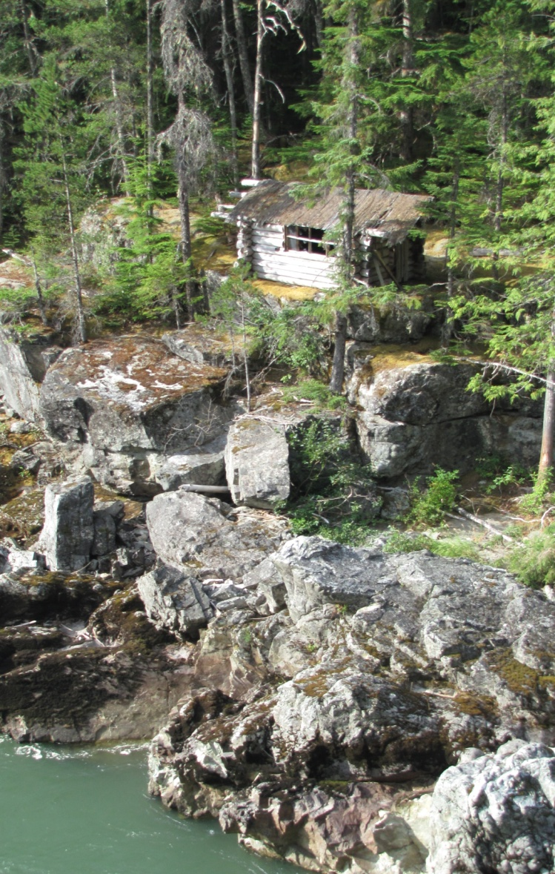
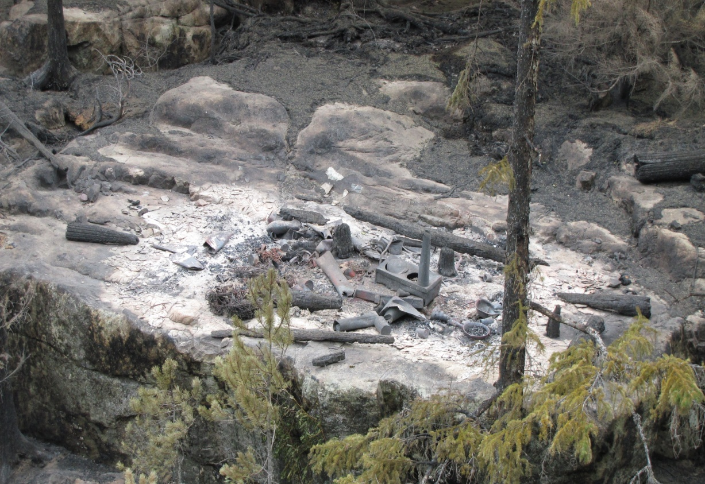
Losses – Trapper Cabin
Notes:
The cabin was old and derelict. Crews did not have time to commence structural protection measures prior to fire blow up and discovery of cabin location.

Slide 26
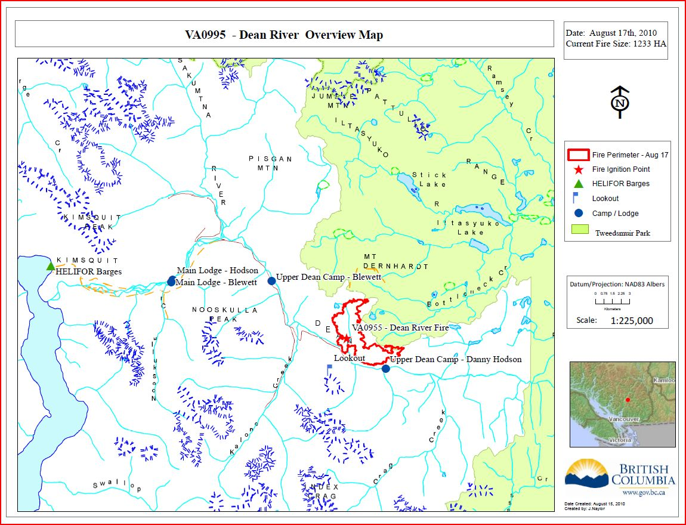
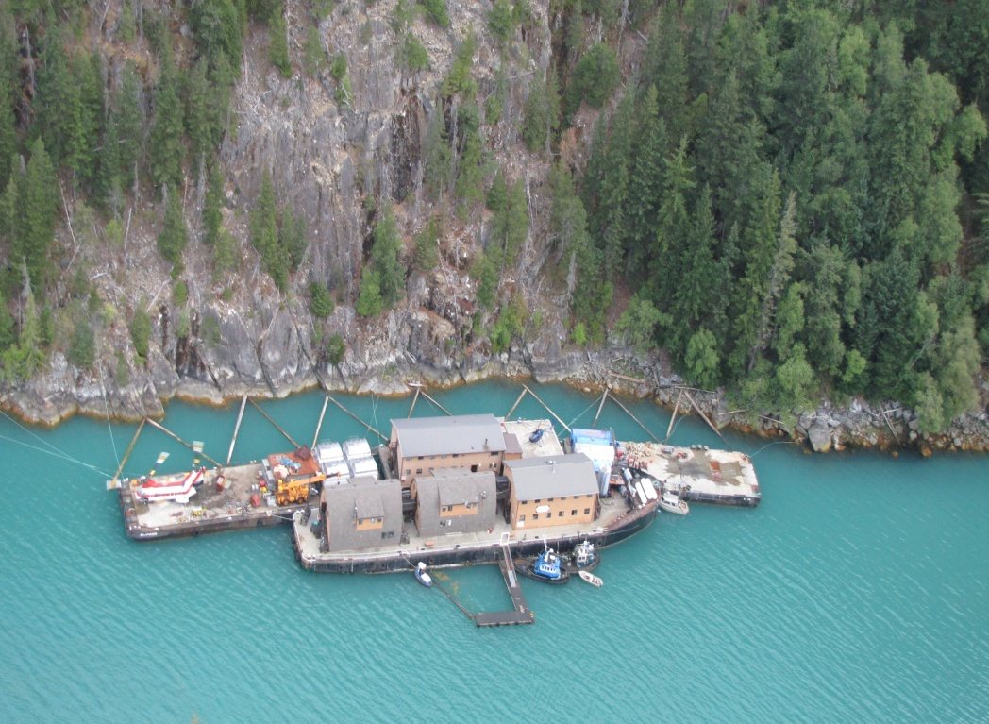
Other Challenges – location
REMOTE LOCATION
Notes:
Helifor barge was re-located to Kimsquit area to house crews, fuel, and helicopters.

Slide 27
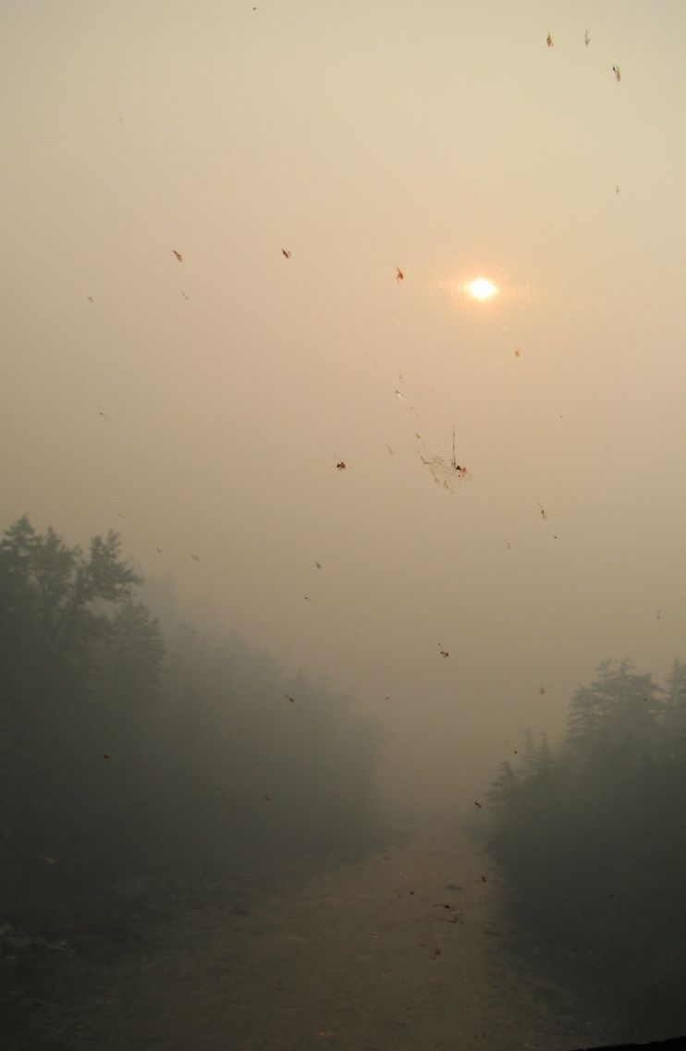
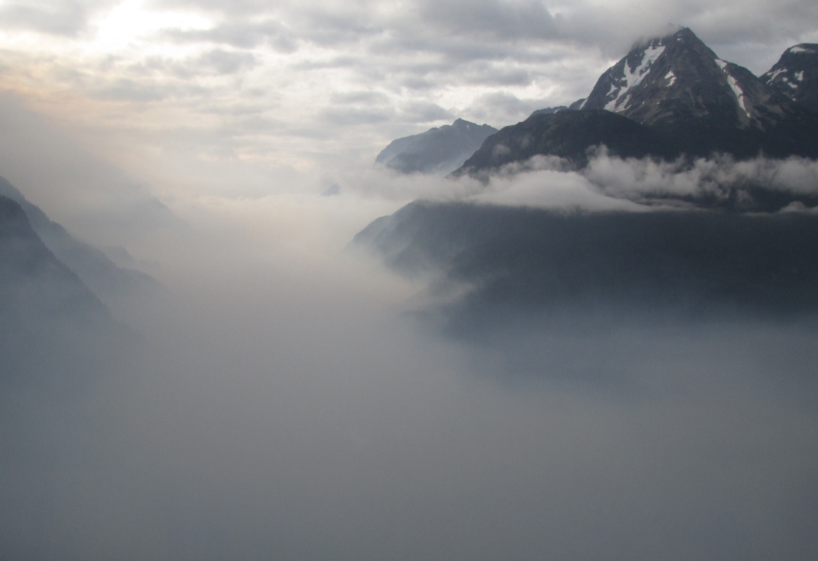
Challenges –
Inversion
DEAN RIVER
POOR VISIBILITY
Notes:
Morning inversions most every day caused poor visibility and raised concerns regarding helicopter flights and crew transport

Slide 28
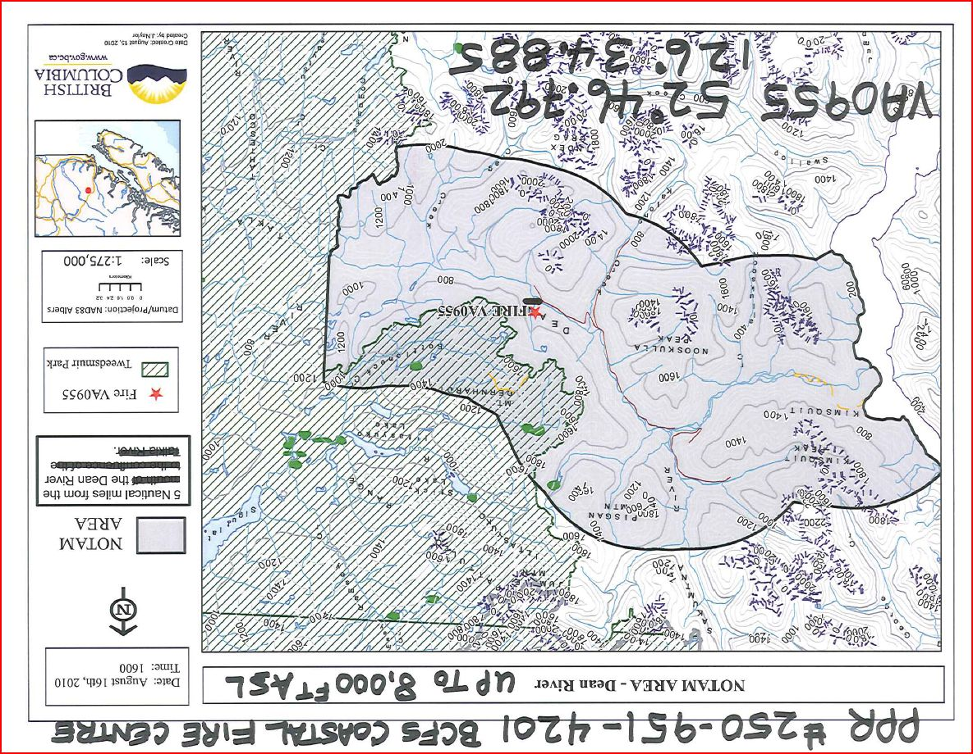
Challenges –
NOTAM
Maintaining control of airspace over fire and other flight routes for helicopters engaged in fire suppression activities
Notes:
There were instances of uncontrolled aircraft flying into restricted airspace outlined in notam. Notams are applied to all major fires in order to restrict air traffic over fires for the safety of aircraft directly engaged in fire suppression activity.

Slide 29
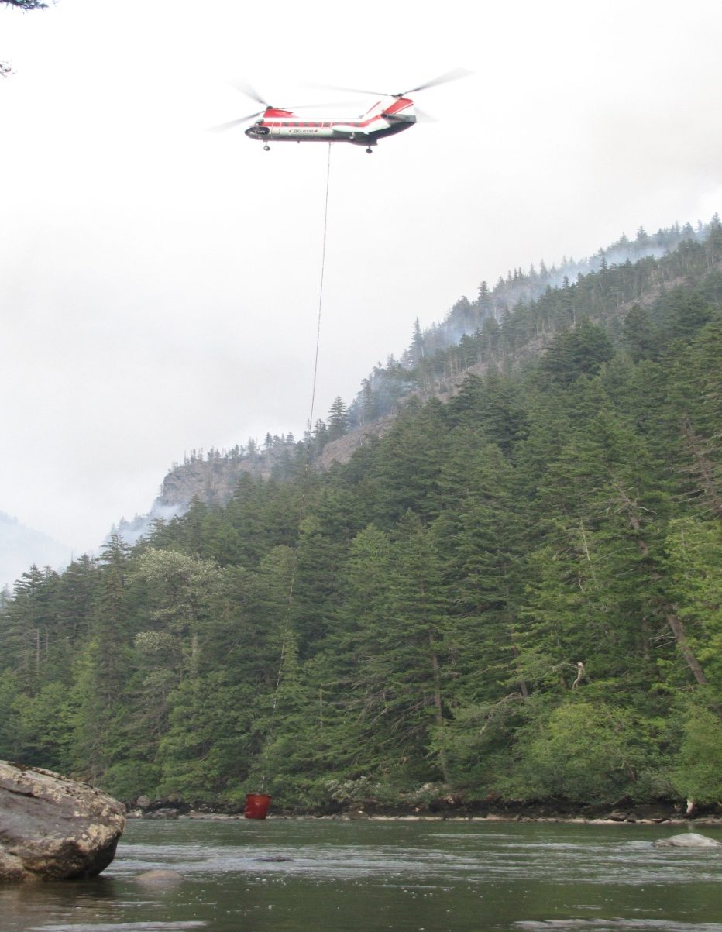
Environmental Impact
No foam or airtanker retardant was used to avoid any environmental impact on the Dean river.

Slide 30
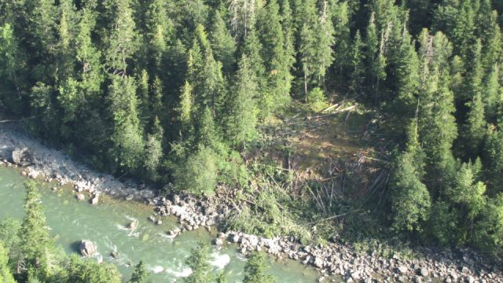
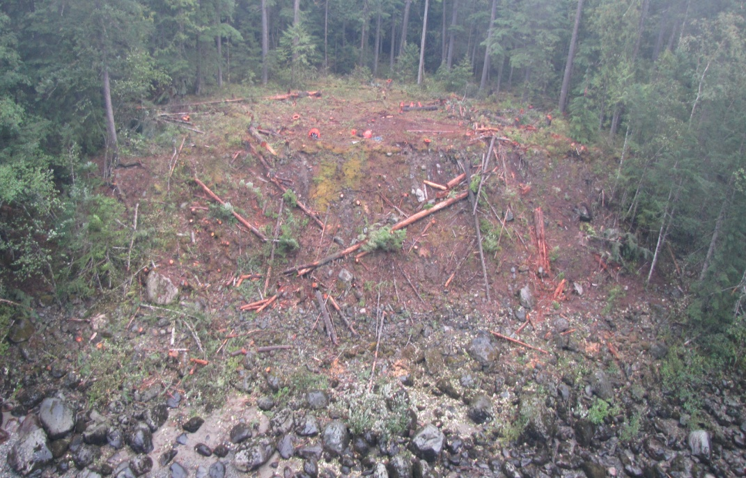
Challenges - Environmental
BEFORE
AFTER
MOST DEBRIS REMOVED
Notes:
Helicopter with grapple was used to remove large woody debris. Crews then did final touch up work by hand. Important to note that the helipads will eventually regenerate and actually enhance biodiversity as young trees and brush grow into a mature forest.

Slide 31
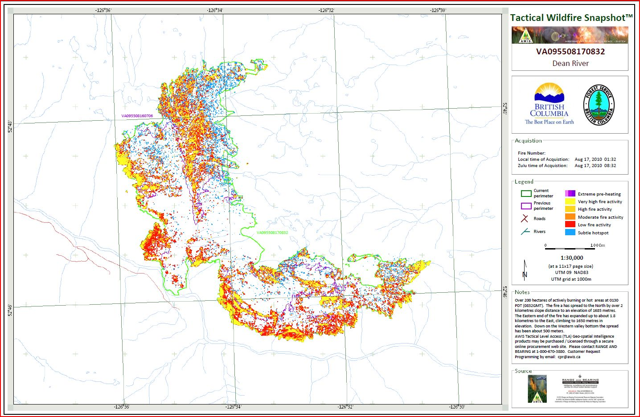
Technology – Scan Maps
Notes:
AWIS scans (High altitude infra-red thermal scans) help to focus resources in areas where heat is detected saving valuable time, effort and expeditures.

Slide 32
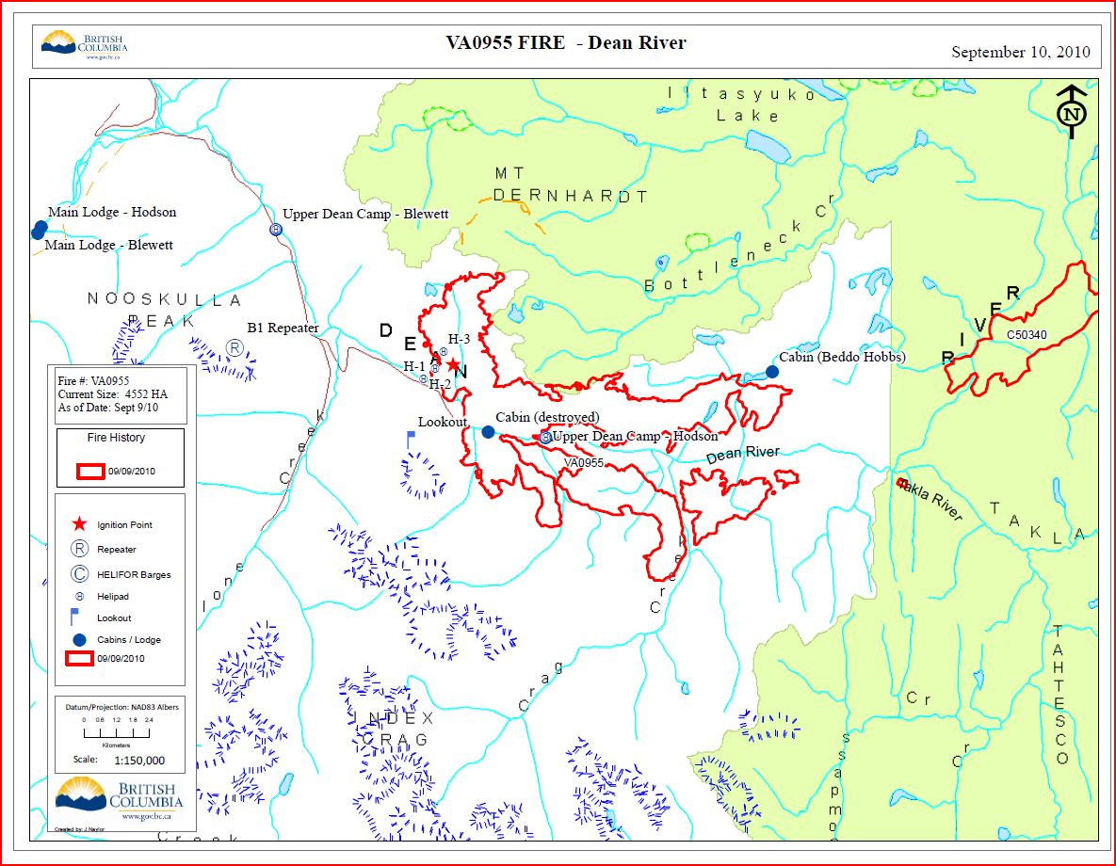
Technology – GIS
Notes:
Maps are an essential tool for on the ground fire fighters and management as well

Slide 33
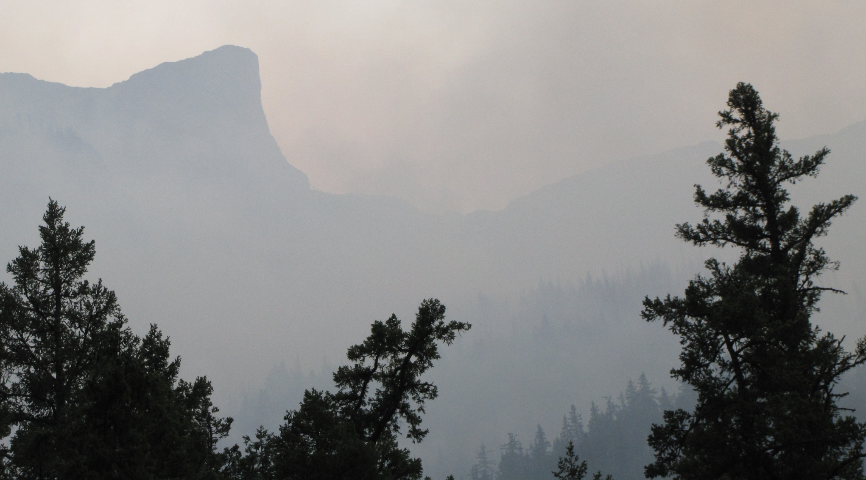
Results
Control Objectives Met
No further fire movement to west
Hodson’s upper cabins saved
Eventually evacuation order was lifted when wet weather systems moved into the area in early September

Slide 34
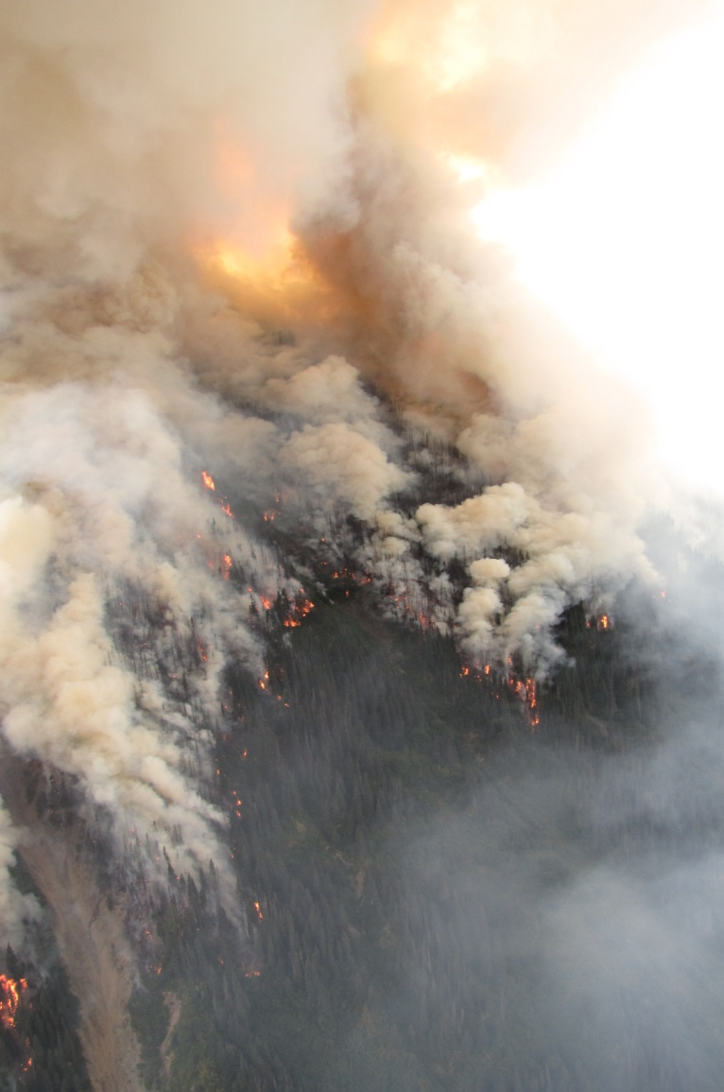
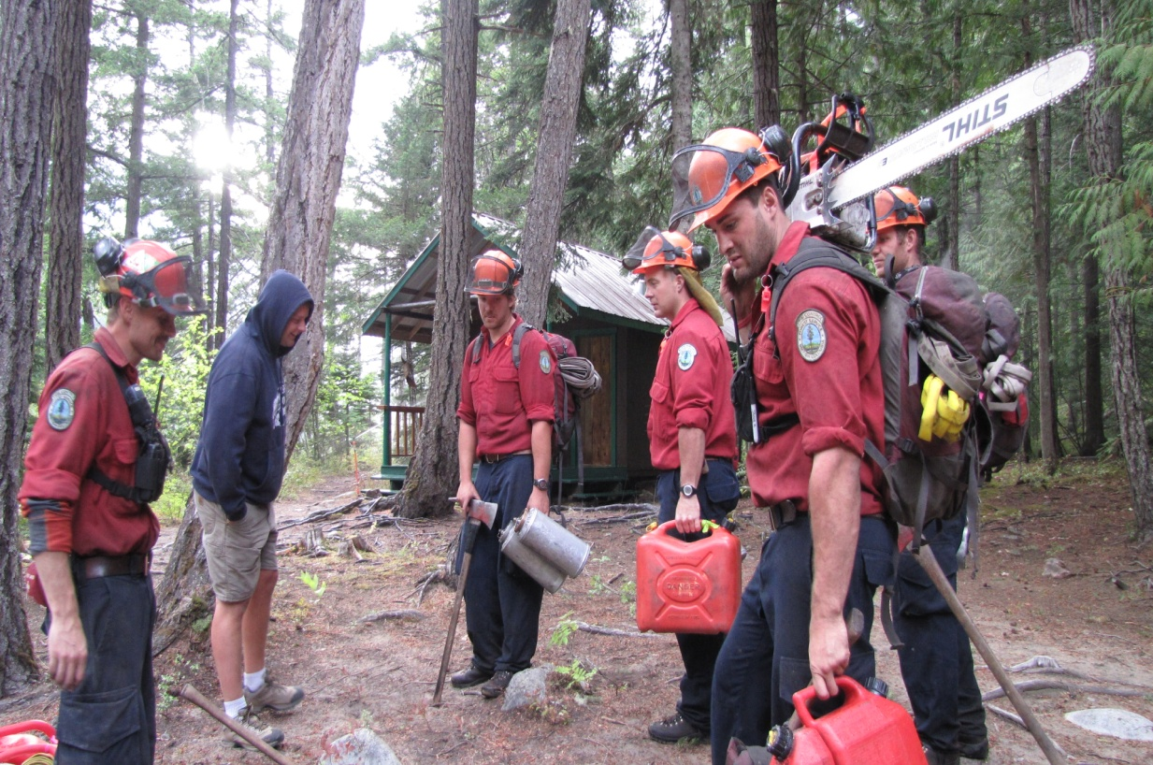
Dean Fire 2011

